Slide 1

ODPB Evaluation Framework
Team
NEO

Slide 2

Business Research

Slide 3
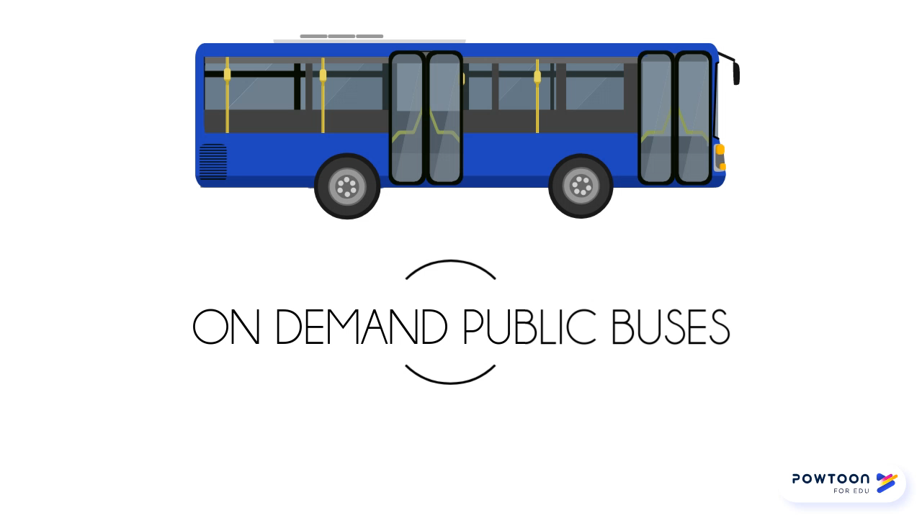
Business Research

Slide 4

Objectives
Objectives
What are the key indicators for the evaluation?
Gather and Analyse the Voice of Customers
What could be the potential data to collect/Simulate
Modelling technique to achieve the objective
More suggestions for LTA
Evaluation framework for LTA to evaluate the On demand Public buses trials

Slide 5
Journey

Slide 6
Framework
Describe the Program
Design Evaluation Framework
Execute
Justify Conclusions
Learn/Explore

Slide 7
Exploration & Design

Slide 8
Exploration
Voice of Customers (Survey/Team Brainstorm)
Critical to Quality Maps
GQM

Slide 9
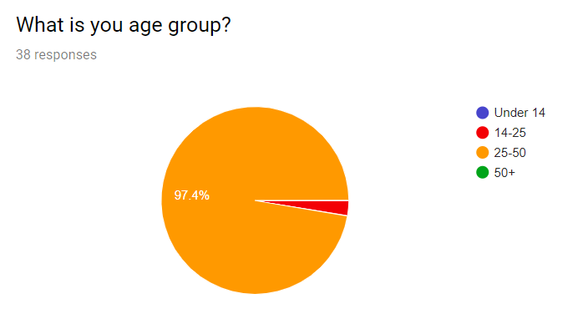
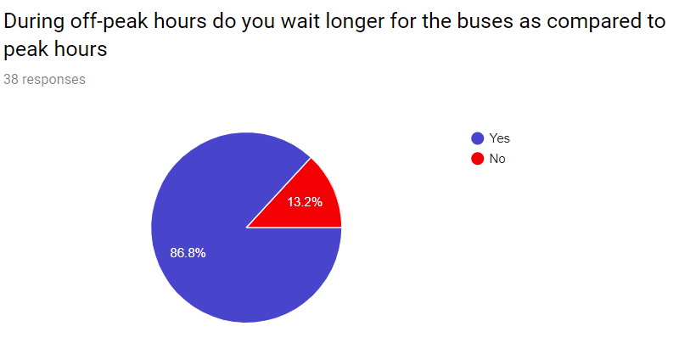
Survey Findings
Notes:
We wanted to find that what is the current pattern of the customer using the bus or cabs in off peak hours. If there are indicators we could find in the survey through patterns

Slide 10
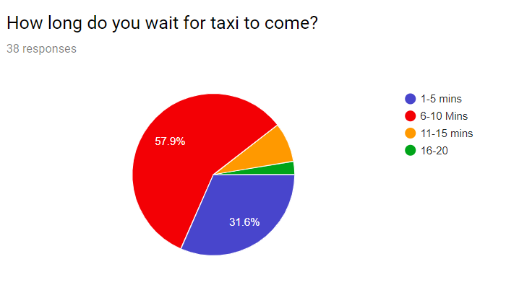
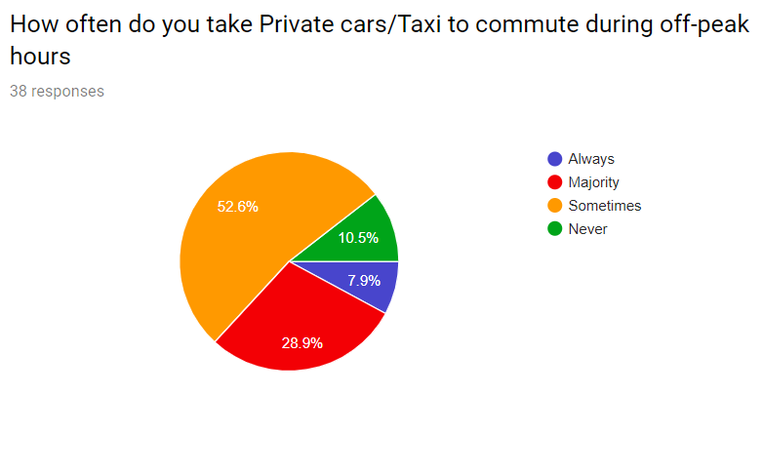
Survey Findings
Notes:
We wanted to find that what is the current pattern of the customer using the bus or cabs in off peak hours. If there are indicators we could find in the survey through patterns

Slide 11
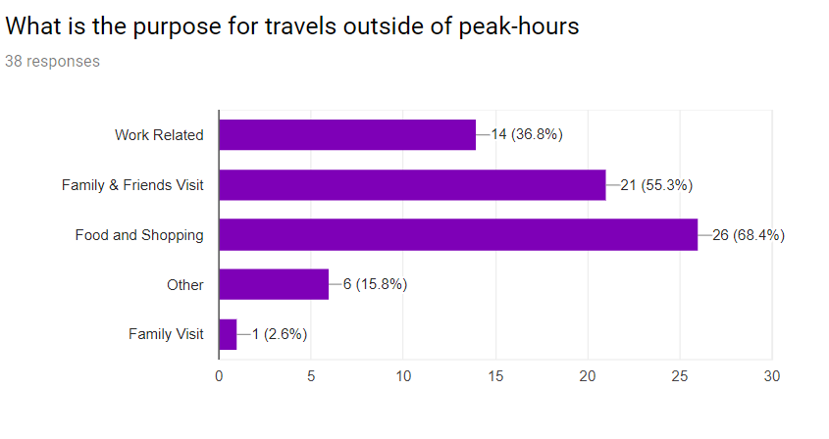
Survey Findings
Notes:
We wanted to find that what is the current pattern of the customer using the bus or cabs in off peak hours. If there are indicators we could find in the survey through patterns. Post the service launch another survey could help with the comparative analysis

Slide 12
Design Framework

Slide 13
Evaluation Framework Design
KPI Identified
Simulation(Trajectory)
Quantile Regression
Multi-Nomial Regression
Notes:
Based on the exploration phase, we ran through the following evaluation framework. Let’s discuss the execution phase by phase.

Slide 14
Result of Evaluation framework
Question to Solve | Service Quality Metrics | Achieve through
How to evaluate impact of On Demand Bus Service? | Analyse and identify passenger’s demand growth | Descriptive Analytics
 | Identify passenger’s satisfaction on ODPB service | Predictive Analytics
 | LTA decision on the cost effectiveness | Linear Programming

Slide 15
Metrics for Passenger’s Satisfaction
Key Attributes | Key Indicator | How To Calculate
Improved Travel time | TravelTime | Travel Time spent from Source to Destination
Waiting time from book to pick | PickupWaitingTime | Time(Bookingsuccess) – boarding (time)
Cancellation by passenger | CancelledTrip | Cancellation recorded in App
Fare paid | FairperJourney | Fare paid for individual journey
Ease of booking | TotalBookingTime | Time to book through app
Notes:
Further, matching the customer pattern and internal findings we could find the following indicators which will help in overall satisfaction of the on Demand public buses service.

Slide 16
Metrics for Passenger Satisfaction(cont.)
Key Attributes | KPIs | How To Calculate
Bus Conditions | BusInfrastructure | Through feedback post travel
Customer service with driver | DriverServiceAttitude | Through feedback post travel
App experience | BookingAppExperience | Through feedback post travel
Customer Overall Experience | OverallExperience | Through feedback post travel
Notes:
Further, matching the customer pattern and internal findings we could find the following indicators which will help in overall satisfaction of the on Demand public buses service.

Slide 17
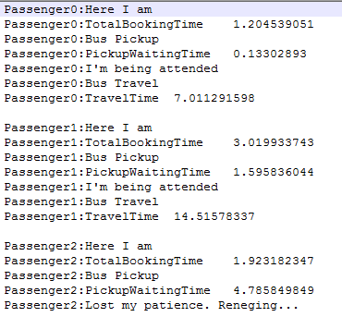
Proof of Concept through – Trajectory Simulation
Simulated What-If scenarios
Total 5297 number of records simulated
Notes:
Based on the exploration phase, we ran through the following evaluation framework. Let’s discuss the execution phase by phase.

Slide 18
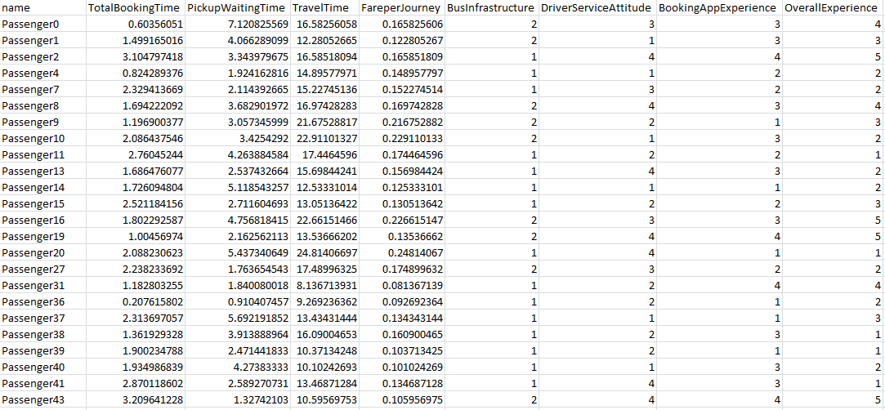
Simulated data output

Slide 19
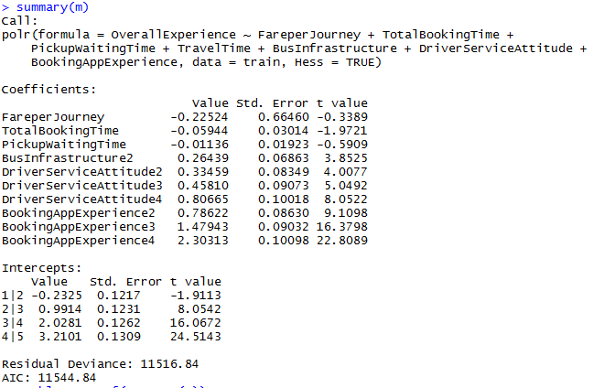
Multi Nomial Ordinal Logistic Regression
Model summary:
Notes:
Based on the exploration phase, we ran through the following evaluation framework. Let’s discuss the execution phase by phase.

Slide 20
Ordinal regression result Interpretation
The Negative sign on the co-efficient suggests that increase in Total booking time, Pickup waiting time and Fare per Journey would result decrease in customer likely experience
One unit increase in Total booking time would result in the odds of customer experience being “very likely” versus “somewhat likely”, “unlikely”, "Worse" are multiplied by - 0.05944. Similarly Pickup waiting time and Fare per journey would impact negatively to the customer likeliness by -0.0113 and -0.2252 respectively.
From the other categorical predictors we can conclude that the overall customer experience on the service would have positive effect with Driver’s service attitude, Booking app experience and Bus infrastructure.
One unit increase in Driver’s service attitude, Booking app experience and Bus infrastructure from 0 to 1, would result in the odds of customer experience being “very likely” versus “somewhat likely” ,“unlikely”, "Worse" on overall service satisfaction would increase likelihood of respective coefficient.
Notes:
Based on the exploration phase, we ran through the following evaluation framework. Let’s discuss the execution phase by phase.

Slide 21
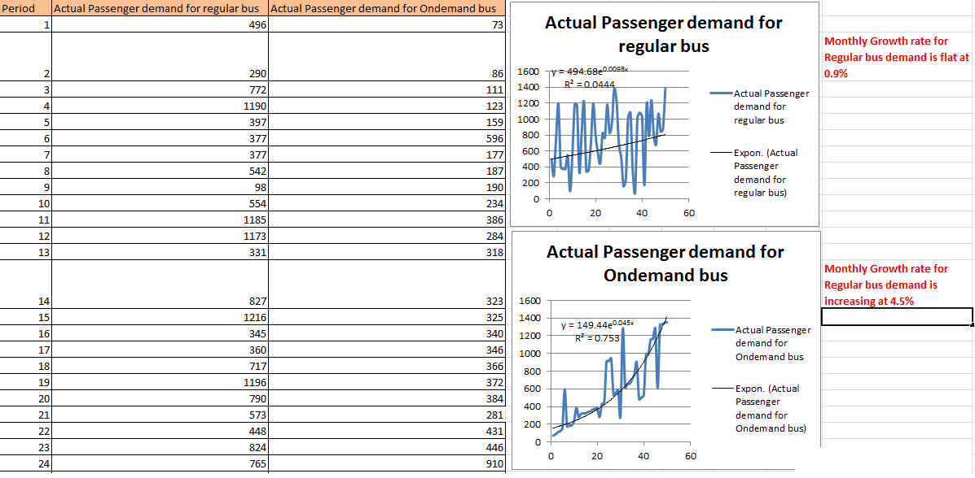
Passenger’s demand growth rate(Simulated)

Slide 22
Driver Scheduling Time & Cost

Slide 23
Driver Scheduling (Time & Cost)
Objective
Equation Definition
Dynamic routing algorithm should optimize overall cost by taking number of drivers required in each working shift along with the associated cost for that shift
Number of drivers required in each working shift is dependent on requirements for each time frame of 2-4 hours
Proposing a linear programming problem to better manage number of drivers and associated cost
Sum of number of drivers should be greater than equal to the requirement in overlapped time frame between consecutive shifts
Count of drivers required in each shift should be an integer

Slide 24
DEMO

Slide 25
Limitations
Survey sample size is not big enough to represent population
Missing Stakeholders engagement
Time Constraint
Notes:
Missing stakeholders engagement which is core of CDL framework. Survey sample is not by area where service is launched and express an idea which could be used by LTA to run in a planned way. There are many other KPIs which might be missing due to the limited research on the topic due to time constraint.

Slide 26
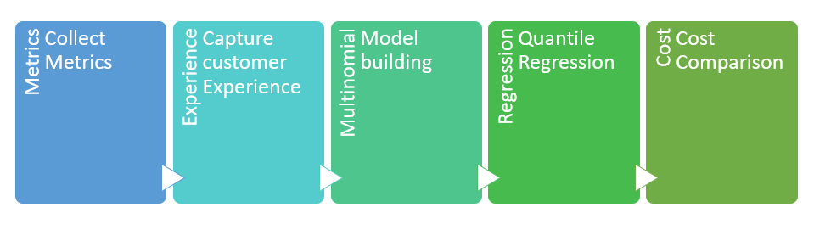
Implementation steps
Analyze the passenger demand growth rate after implementation and collected the demand data
Create Predictive model to from the metrics to determine passengers satisfaction.
From the predictive model set the SLA to the service provider to meet commuters expectation
Optimize cost by effectively utilizing the resources.

Slide 27

Thank You

